Slide 1
Po-Do
A study website for those that
have trouble with time management
and concentration
By Andy Wolf, Yannis Panou, Mecarah Son, David Amaya

Slide 2

Description
Po-Do is a website that allows users to keep control of their tasks by implementing the pomodoro technique. This technique helps users with their time management issues and concentration in order to not get burnt out as fast from their extensive workload. While the user is setting up the tasks that they want to finish, they also have the option to control music they would like to listen to. Hopefully the website will be useful to those that need it and struggle with time management skills and concentration.

Slide 3
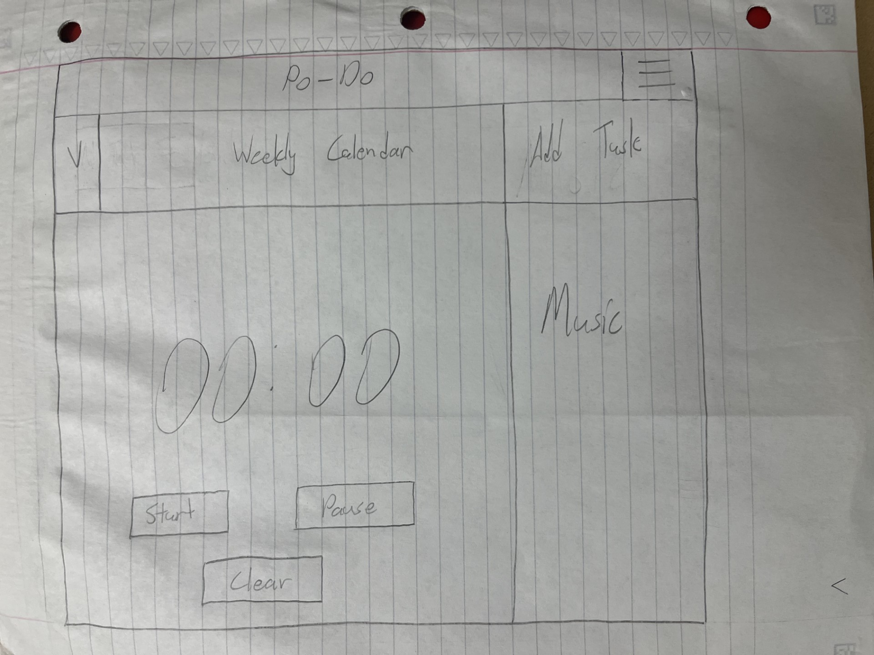
Main Page

Slide 4
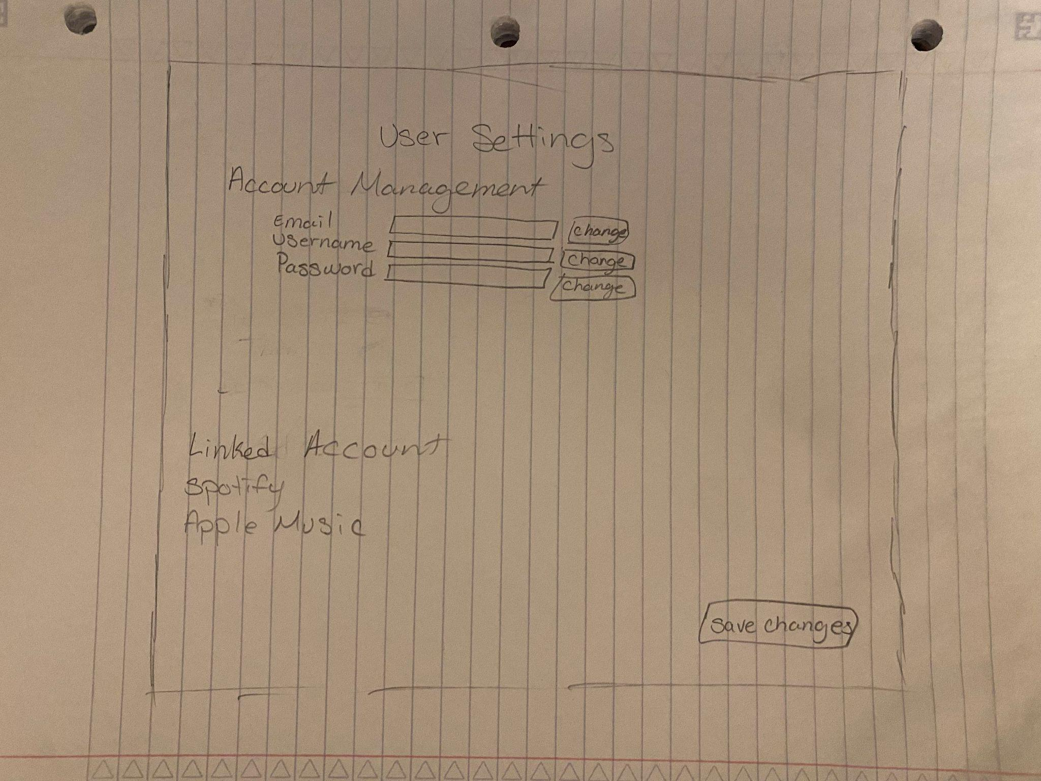
User Settings

Slide 5
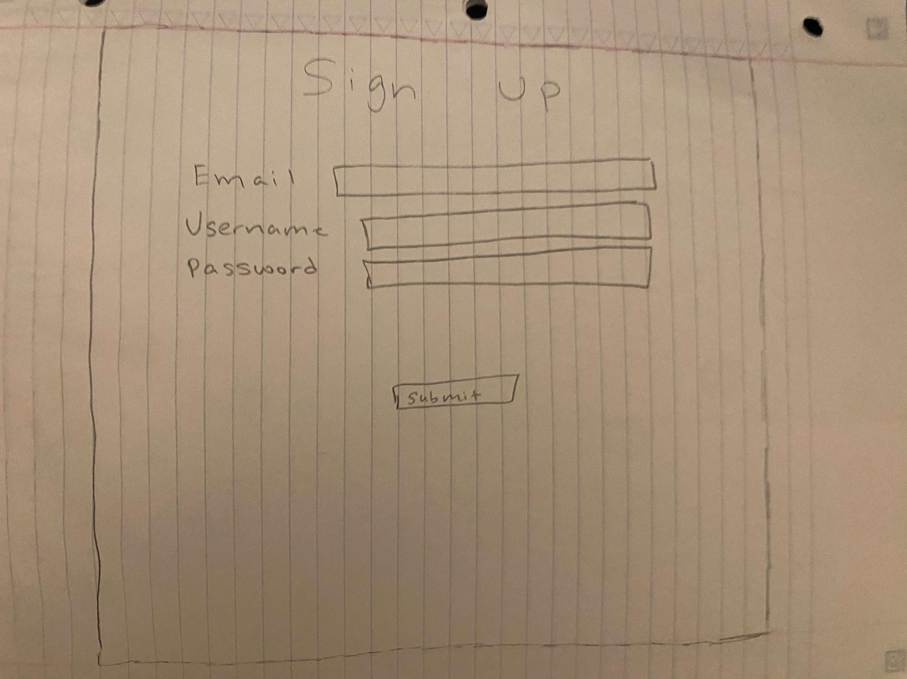
Sign-Up page

Slide 6

Functionality, Features and
Database Specifications
Signing Up and Logging In
Setting Study Session Time
Setting Break Periods
Creating Tasks
Updating Tasks
Deleting Tasks
Setting Deadlines
Store Username, Password and User Details/ in database
Updating Time Periods
Notifications for Time Periods
Announcements for Deadlines
Music Overlay
Calendar of Tasks/Deadlines
Dropdowns/Pop-outs/UX
Stores Users music accounts
Disallow “non-members” access to user settings and music

